Slide 1
AdMeta
A privacy-preserving Ad Platform in Metaverse
AdMeta Team

Slide 2
Background

Slide 3
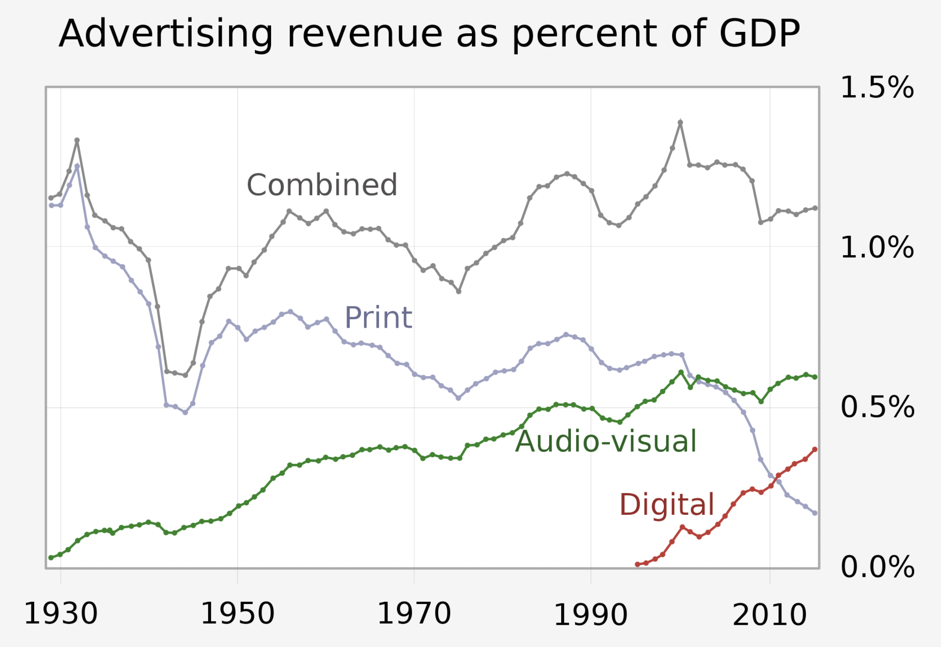
Advertisement Evolution
Online advertising has grown rapidly to become the major part in the advertising industry, since it emerged
Advertising becomes diversified, traceable and precise, with the growing of Web2.
In Web3 and Metaverse, advertising is still in great demand.
Advertising revenue as a percent of US GDP

Slide 4
Demand

Slide 5
Advertising Demand
In Metaverse, a rapidly growing number of projects has created a huge demand for advertising
Projects are looking for an ad platform with precise targeting and tracking
Virtual landholders are willing to monetize ad impressions

Slide 6
Users Demand
Users are willing to try new products that suit their tastes
In the other hand, users are unwilling to expose their privacy to advertisers

Slide 7
AdMeta

Slide 8
What is AdMeta?
AdMeta is a Metaverse ad platform that focuses on privacy preserving
User’s private data is stored on the TEE layer of blockchain
TEE ensures that advertisers can accurately deliver ads to end users without knowing users information
Users are incentivized by completing advertiser’s advertising tasks
Ads are delivered to users according to their wishes and preferences
Spam advertisers cause staking slash, and spam users cause credit decline

Slide 9
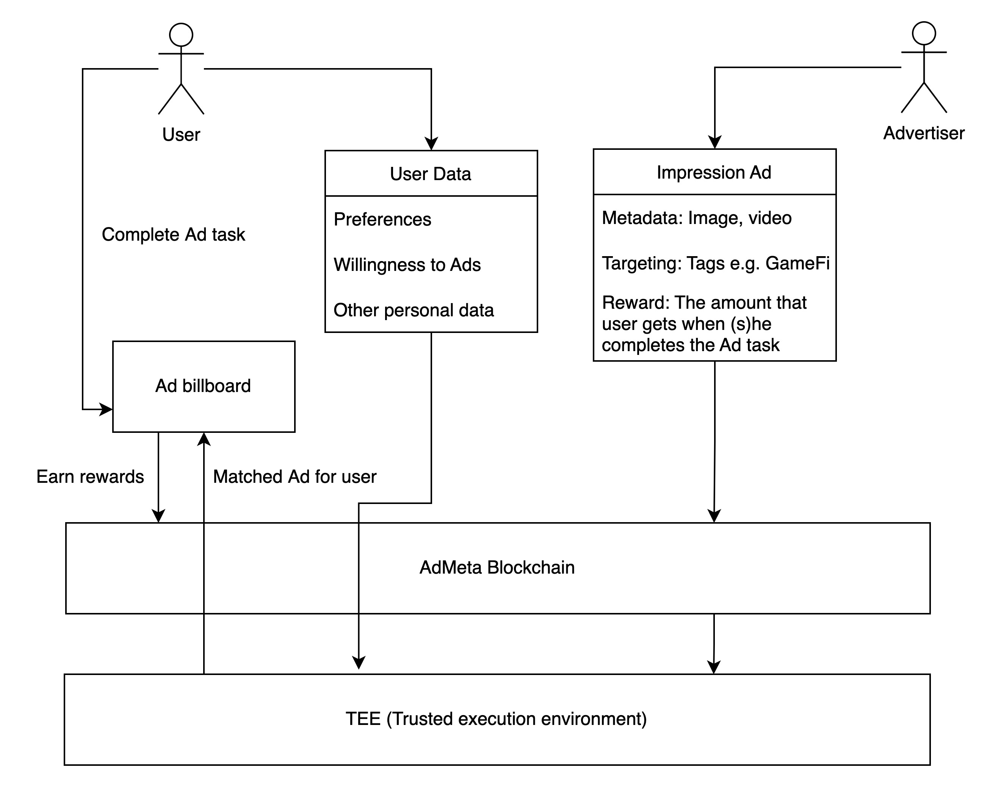
Workflow

Slide 10
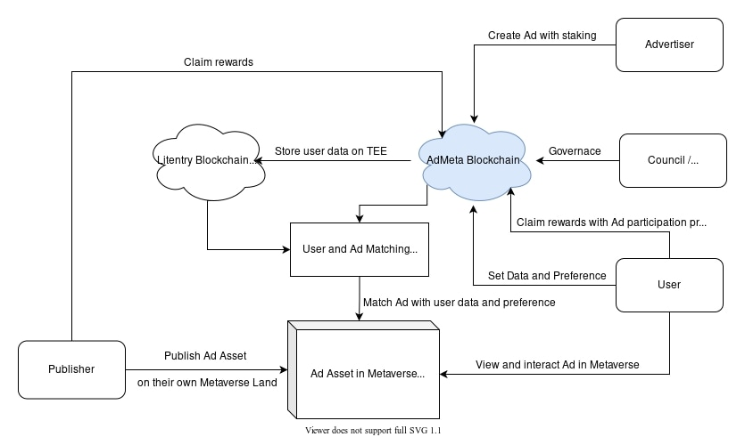
Architecture

Slide 11
Milestone

Slide 12
Milestone 1 - AdHub (Q2 2022)
Create a virtual land space on popular Metaverse platforms, and show interactive ads of our cooperated projectsTEE ensures that advertisers can accurately deliver ads to end users without knowing users information
Build a web app, with which users can connect with their LIT wallet and claim rewards
Milestone 2 - AdFeed (Q3 2022)
Users are able to either provide their preferences or link via MCP to AdMeta so that they can receive customized ads
Ads are sorted into categories and displayed according to users’ preferences
Milestone 3 - TEE integration (Q4 2022 - Q1 2023)
Storing and accessing sensitive data will be implemented in the TEE layer
Web app will be re-designed to adopt the new architecture
Milestone 4 - AdAsset (Q2-Q3 2023)
AdAsset will be provided by us on popular Metaverse platforms, and landholders can use it on their lands with drag-n-drop

Slide 13
Video

Slide 14
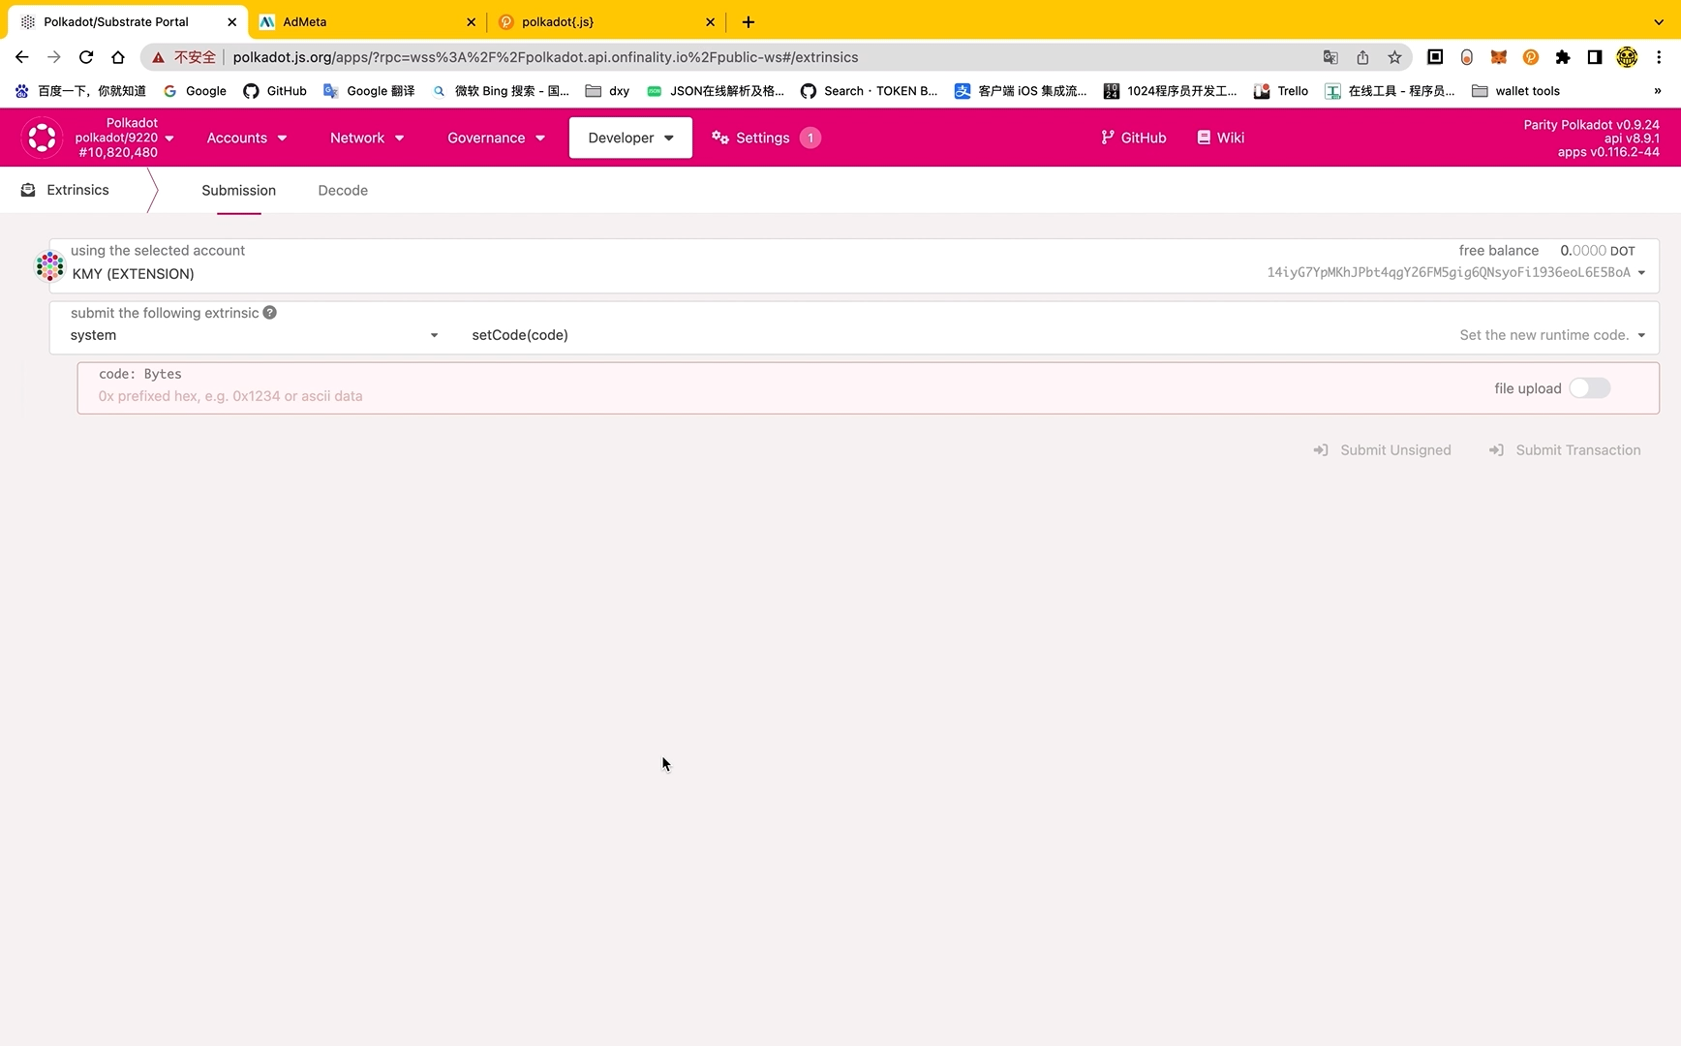

Slide 15
Team

Slide 16
Han - Team Lead & Substrate Dev
Will - Backend Dev
Kmy - Frontend Dev

Slide 17
Contact Us

Slide 18
Website: https://admeta.network/
GitHub: https://github.com/AdMetaNetwork/
Twitter: https://twitter.com/AdMetaNetwork

Slide 19
Thank You

